Slide 1
CIA PROJECT
Operational Manual: Reflection and results
Erasmus + 2019-2-ES02-KA205-013840
This project has been funded with support from the European Commission.
This publication reflects the views only of the author, and the Commission cannot be held responsible for any use which may be made of the information contained therein.
Notes:
1

Slide 2
Reflection and results
This will help you put into operation the Intergenerational Civic Councils both for facilitators (young people whose job it is to administer the Councils and to achieve measures / actions / projects / proposals , etc.) and interlocutors (whose mission it is to build a bridge between the Intergenerational Civic Councils and other structures).
Notes:
2

Slide 3
LOCAL CIVIC INTERGENERATIONAL COUNCILS
❖ Staff: Civic Intergenerational Agents [elderly collective – Young people]
❖ Target group: young collective
❖ Service: - improvement of their skills
- active search for employment
- socio - labour integration
Notes:
3

Slide 4
Expectations?
Young People
Older People
Notes:
4

Slide 5
Minimum results to be accomplished:
❖ Improve the employability of young people with low professional qualifications and/or development of skills
❖ Give young people the opportunity to improve their soft skills by creating councils in which young and old collaborate mutually, sharing knowledge, experiences and interpersonal skills
❖ Improve key competences of young people linked to intergenerational dialogue
❖ Support actions to promote active ageing by young people civic decision-making
❖ Empower young people through the transmission of knowledge and experiences by older people
5
Notes:
5

Slide 6
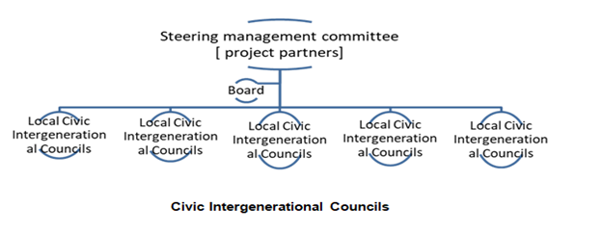
To accomplish the above results, it is necessary to create a minimum structure that will manage the Civic Intergenerational Councils:
6
Notes:
6

Slide 7
EVALUATION - 0utputs of the activities, The Effect on the people as a result of the activities; The over-all Impact or change
There are two levels of evaluation:
❖ Implementation of Local Civic Intergenerational Councils;
❖ Work implemented by “Local Civic Intergenerational Councils”.
7
7
Notes:
7

Slide 8
EVALUATION SHEET
scale | The quality and quantity of work produced by the LOCAL CIVIC INTERGENERATIONAL COUNCILS | Mark √
1 Poor | Has made frequent errors that are harmful to “councils” operations.
 | The supervisor has received numerous complaints about the quality of work.
 | The quality of work produced is unacceptable
 | Does not complete required paperwork.
8
8
8
Notes:
8

Slide 9
EVALUATION SHEET
2 Needs Improvement | Is not as careful in checking work product for errors as it could be
 | Tends to miss small errors in work service
 | Required paperwork is completed late or is only partially complete
9
9
9
Notes:
9

Slide 10
EVALUATION SHEET
3 Meets Requirements | Does not require constant supervision
 | Error rate is acceptable, and all work is completed timely
 | Forms and required paperwork are completed on time with minimal errors
10
10
10
Notes:
10

Slide 11
EVALUATION SHEET
4 Exceeds Requirements | Managers and co-workers have commented on high levels of accuracy and work productivity.
 | Takes pride in work and strives to improve work performance.
 | All memos, reports, forms and correspondence are completed on time with no errors.
11
11
11
Notes:
11

Slide 12
EVALUATION SHEET
5 Outstanding | Has less than a 1% error rate on work service.
 | Accuracy is excellent.
 | Quantity of work produced is outstanding.
12
12
12
Notes:
12

Slide 13
The OPERATIONAL MANUAL FOR THE FUNCTIONING OF THE LOCAL CIVIC INTERGENERATIONAL COUNCILS are published on the project's website
13
13
13
13
Notes:
13

Slide 14
14
14
14
14
Notes:
14

